Slide 1

EY Techathon 6.0 Detailed Submission
Date of submission:

Slide 2

Congratulations on making to the next round. As we move towards the next stage, we would like you to note a few key points
We are inviting a detailed solution submission for the next round. The ppt document that you submit should cover the below :
Team Details (refer slide 3 – pictures should be high resolution; Size: 1200X1800 | 2MB; Front facing camera; Attire: Formal | Presentable | No accessories like sunglasses etc | Plain background)
Executive Summary (refer slide 4)
Problem statement and Solution proposed (refer slide 5)
Approach and methodology (refer slide 6)
Details to be submitted separately (refer slide 7)
Working prototype/output (refer slide 8 - this is key to your presentation and you/ your team will be expected to screen share and demonstrate the same if you make it to semi-finale round) (kindly record and share the video file of the prototype demonstration (as a backup file))
Expected output should be in form of demonstratable technology solution (This is mandatory)
Evaluation parameters
Scope of the problem covered in the solution
Solution design and use of technology
Uniqueness of Solution and Innovation
End-user benefit and impact
Please upload your submissions on the Unstop website (PPT in .pptx, Video files in .mp4 formats only)
Submission link will be live on XX. Last date for submissions is XX.

Slide 3



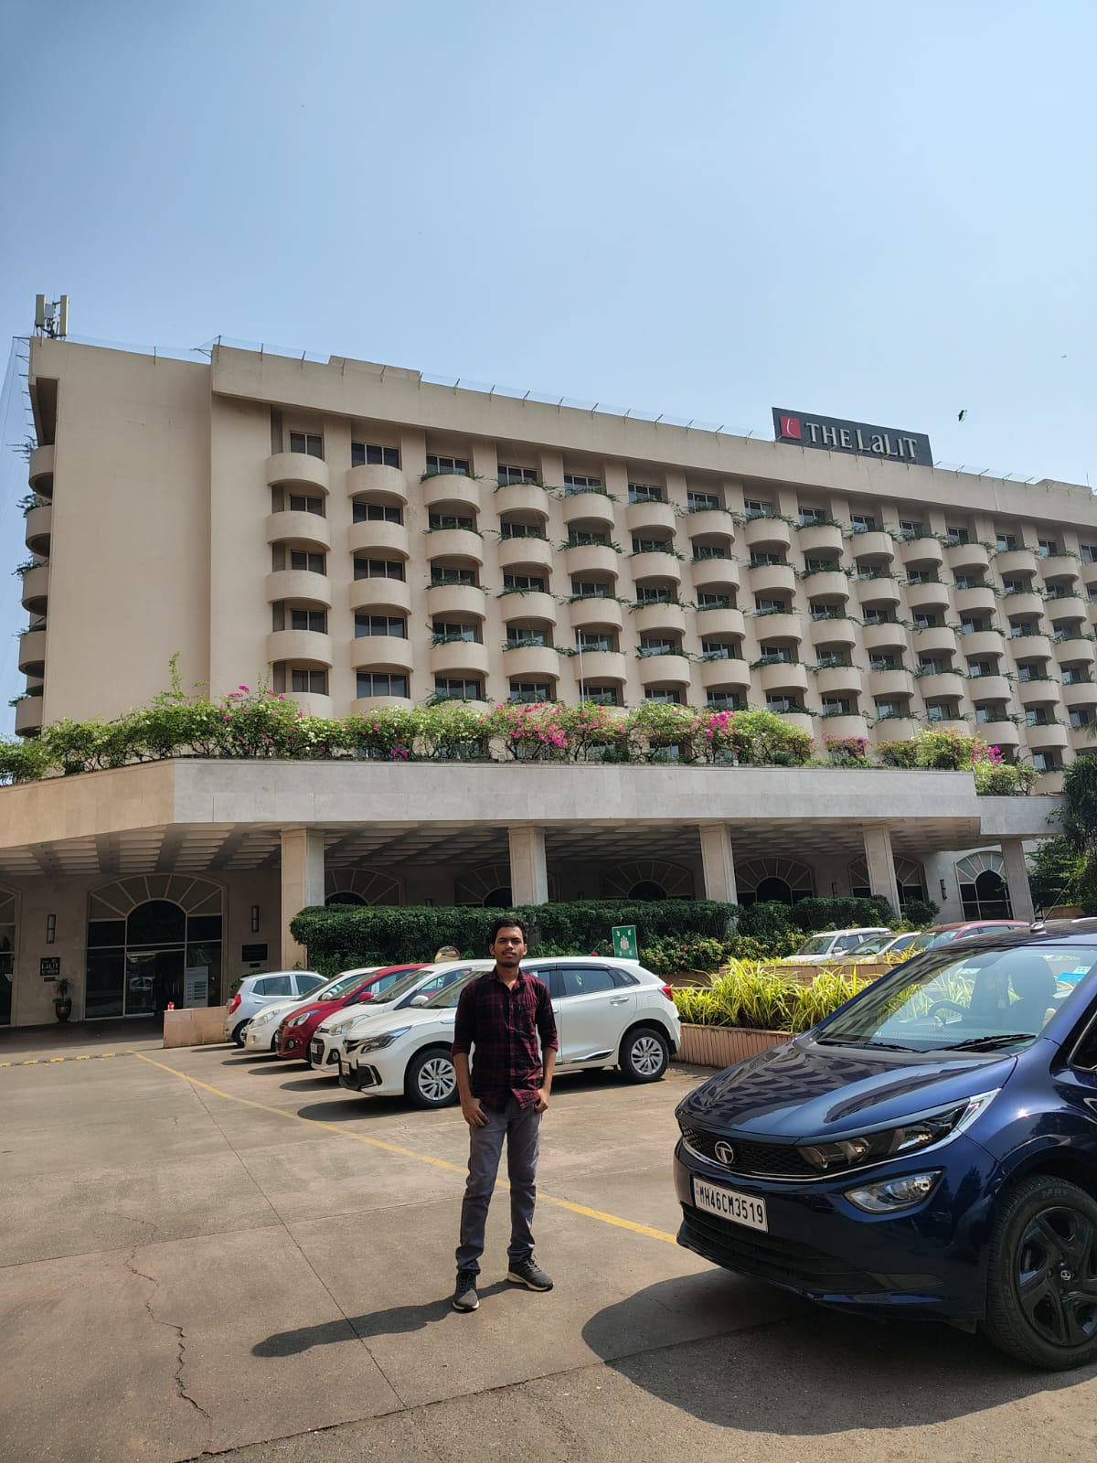
Tell us about yourself | Highlight a technical skill or skills each member brings to the team
Team Name: Status200
Problem Statement : PS 1: Pharma
Team Member 1 pic
Team Member 2 pic
Team Member 3 pic
Team Member 1 Name : Vedant Modhave
College name : TSEC
Contact Detail (phone number) : 9321581920
Role in Solution Development:
Full-Stack Developer (Frontend + API integration)
Team Member 2 Name : Jatin Gorana
College name : TSEC
Contact Detail (phone number) : 9987265862
Role in Solution Development :
Data Engineer (Web scraping & data pipelines)
Team Member 3 Name : Shravan More
College name : TSEC
Contact Detail (phone number) : 7304308869
Role in Solution Development : ML/NLP Specialist (Entity matching & data enrichment)

Slide 4
Executive Summary (minimum 200 words)
The global generics market has become increasingly competitive, with shrinking margins and limited room for differentiation. To stay ahead, pharmaceutical companies are now turning toward value-added innovation repurposing approved molecules, exploring new indications, developing novel dosage forms, and targeting unmet needs across patient segments. But identifying these opportunities is slow and effort-intensive. Today, teams spend two to three months manually reviewing scientific literature, clinical trial data, regulatory updates, trade patterns, internal insights, and patent filings. The process is fragmented, repetitive, and dependent on individual expertise, resulting in delays and inconsistent outcomes.
Our solution introduces an Agentic AI platform designed to dramatically accelerate early-stage innovation scouting. Users interact with a simple conversational interface to explore any molecule or therapeutic area. Beneath this, a Master Agent coordinates a set of Worker Agents, each responsible for a specific research dimension—market intelligence through IQVIA mock APIs, EXIM trends, patent landscapes, clinical-trial activity, scientific publications, and synthesized internal documents. These agents operate in parallel, pulling structured insights that the Master Agent unifies into an evidence-backed innovation story.
The system enables pharma strategy teams to evaluate opportunities in minutes instead of months, uncover whitespace through unmet-need analysis, monitor competitive activity, and validate product concepts quickly. With automated reporting, interactive exploration, and high-quality reasoning, the solution improves research throughput, enhances decision accuracy, and strengthens the innovation pipeline. Delivered as a web application with auto-generated PDF summaries, the platform fits seamlessly into existing strategic workflows and supports scalable, repeatable innovation discovery.

Slide 5
Problem statement - Your understanding
Define the exact problem that you intend to solve and your understanding of the same. Share the below details:
Problem Statement: The pharmaceutical industry struggles with slow, fragmented early-stage innovation scouting. Identifying new therapeutic opportunities or repurposing existing molecules requires manually gathering data from regulatory sources, clinical-trial registries, scientific literature, and patent databases. This leads to long research cycles (often 2–3 months), overlooked opportunities, and difficulty evaluating competition. The volume of unstructured information further slows analysis and limits strategic decision-making. Our solution uses Agentic AI to automate and accelerate molecule discovery, unify insights across domains, and provide a faster, data-driven foundation for portfolio planning.
Target Industry: Pharmaceuticals
Industry Type: B2B
User Group: <<User Group Name>>
User Department: Innovation and Portfolio Planning
Solution Scenario: The solution is an interactive platform where users can input natural language queries related to molecule discovery, therapeutic areas, or competitive landscapes
Proposed Data Flow: user → master agent worker agents (IQVIA, EXIM, Patent, Clinical Trials, Web Intelligence, Internal Docs) → synthesis → PDF
Nature of Output: Web App

Slide 6
Explain, in brief, how you intend to solve the problem at hand. Preferably include the following (Methodology/approach):
Please elaborate on the solution value proposition to the target user group. How will your solution cover the problem areas?
Response: Our solution gives strategy, R&D, and medical teams a unified platform to explore molecule opportunities quickly. By automating searches across regulatory data, clinical trials, patents, market signals, and scientific literature, it eliminates manual effort and reduces research timelines. The system provides structured insights, highlights unmet needs, and supports evidence-based decision-making, directly addressing fragmentation, slow cycles, and inconsistent evaluations.
What are the impact metrics that you propose to use to analyse the effect of the solution?
Response: - Reduction in research time (baseline 2–3 months → minutes/hours) - Increase in number of molecules evaluated per analyst - Accuracy and completeness of insights retrieved - User adoption and time saved per query - Quality of final innovation stories (completeness, coverage, justification)
What are the technologies (languages, platforms, APIs, hardware, sponsored tools, technologies stacks, framework etc.) involved?
Response: Backend: Python, FastAPIAgent Framework: LangGraph / CrewAI Frontend: React Data Layer: Mock APIs (IQVIA, EXIM, Patent, Clinical Trials), internal PDF repository Processing: Vector embeddings, retrieval pipelines Output: PDF generator (ReportLab/Node-based tools) Deployment: Docker
Please state the assumptions, constraints and solution decision points (Reason behind choosing a technology)
Response: - Assumption: Mock APIs approximate real-world data sources. - Constraint: No access to actual paid databases. - Decisions: Chose LangGraph/CrewAI for modular, multi-agent workflows; chose React for UI; used Python for flexibility with data parsing and NLP tasks.

Slide 7
Explain, in brief, how you intend to solve the problem at hand. Preferably include the following (Methodology/approach):
How easily can your solution be implemented and how effective will it be?
Response: The system can be implemented quickly using modular agents and mock APIs. Its effectiveness comes from automating repetitive research tasks, improving data completeness, and enabling rapid evaluation of new opportunities.
How robust / secure / easily scalable and extensible is the solution?
Response: The architecture is modular, allowing agents to scale independently. API-based design supports secure data handling and integration with internal systems. Components can be extended for new data sources and additional agents with minimal changes.
What are the solution components that you would like to build and demonstrate; if you progress through next round.
Response: - Master Agent orchestrating queries - Worker Agents fetching mock data - Molecule discovery workflow - Trial, patent, and unmet-need insights - Final synthesized PDF innovation report - Web UI showing end-to-end flow

Slide 8
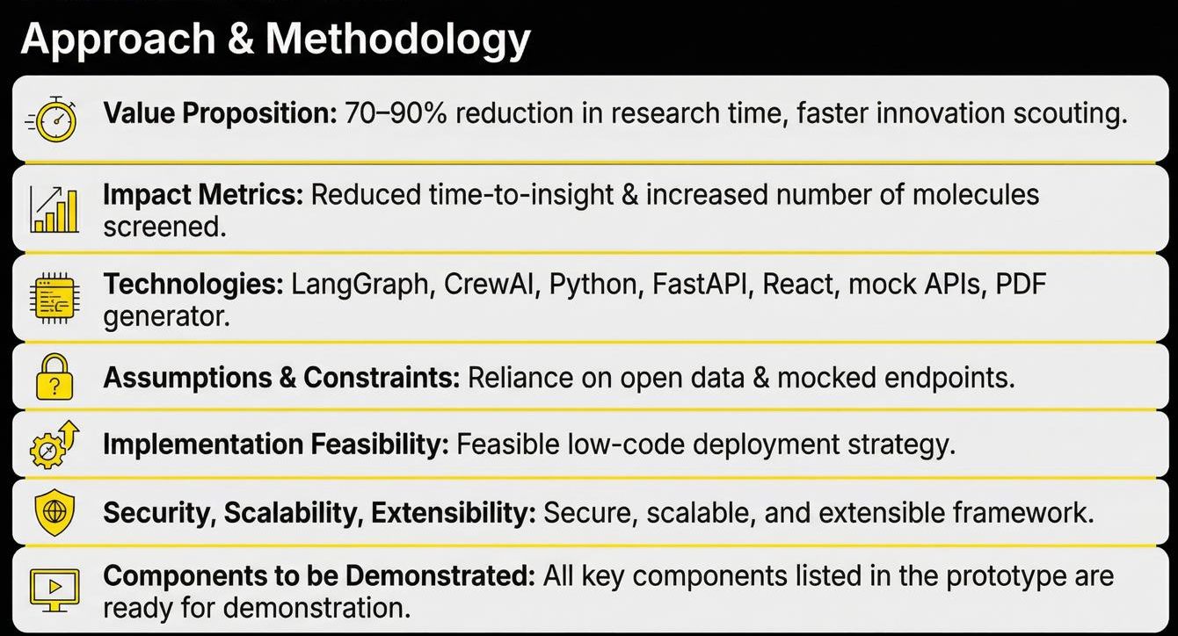
Explain, in brief, how you intend to solve the problem at hand. Preferably include the following (Methodology/approach):

Slide 9

Attach and submit the below as separate files or separate slides
Architecture diagram (mandatory) team to add a slide
Flow chart (mandatory) team to add a slide
Wireframes (mandatory) team to share as a screenshot as a separate slide or as a separate pdf file
Graphical representation (bar graph, histogram, pie charts, heat maps) (optional)
Analysis, visualization (optional)
Code Repository (optional)

Slide 10
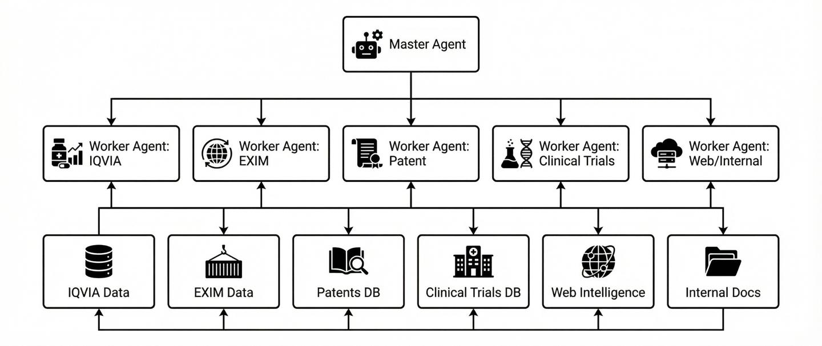
Architecture Diagram

Slide 11
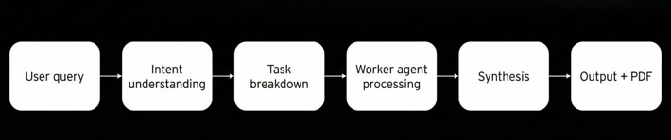
Flowchart

Slide 12
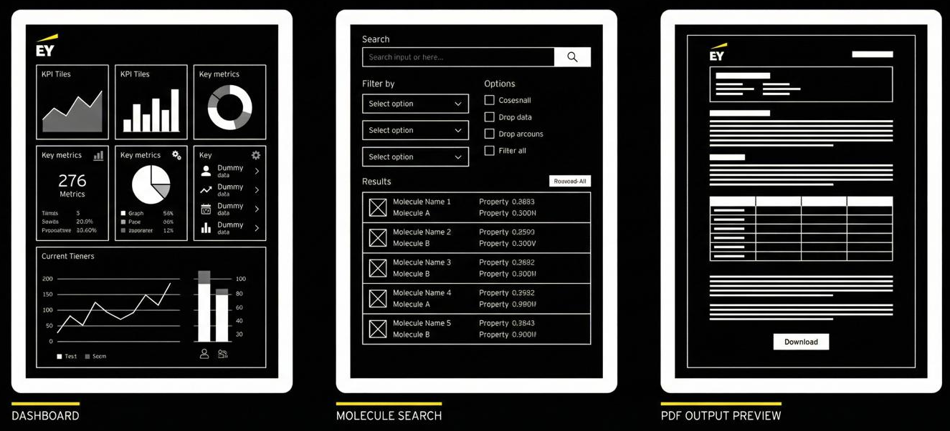
Wireframes

Slide 13



[Attach Video, link for demo] or [output/visualizations from the prototype] Working prototype/output – please add Screenshot or video clip of your prototype here

